Slide 1
INFO 5602
Information Visualization
Group Project Reporting

Slide 2


From Beans to Business: Data-Driven Insights from Coffee Shop Sales

Slide 3
Team Members
Rishekesan Senthil Kumar Vanathi​
Sruthijha Pagolu​
Vikash Baabhu Ramesh Baabhu

Slide 4
Table of Contents
Project Overview & Context
Problem Definition & Research Questions
Project Motivation & Relevance
Methodology
Data Sources
Data Analysis Approach
Exploratory Data Analysis (EDA)
Key Insights & Findings
Conclusion

Slide 5
Context
This project analyzes 149,116 transactions from a New York City coffee-shop chain with three locations: Hell’s Kitchen, Astoria, and Lower Manhattan, collected between January 1 and June 30, 2023.
Each transaction includes date, time, store, product details, quantity, and unit price, allowing us to derive trends in revenue, demand, and purchasing behavior.
The business offers a range of Coffee, Tea, Bakery items, Drinking Chocolate, Coffee Beans, and branded products.
Our goal is to transform raw sales logs into actionable visual insights that inform staffing, inventory, and marketing decisions.

Slide 6
Problem Definition
Problem: The coffee shop chain possesses extensive transaction data but lacks a clear visual narrative that reveals when customers buy, what they buy, and which stores or products drive revenue.
Research Questions:
Temporal Trends: How do sales vary over time (by month, day of week, and hour of day) across the six-month period?
Store Performance: How do the three store locations differ in revenue, order volume, and average order value (AOV)?
Product Drivers: Which product categories and product types generate the most revenue and sales volume?
Business Actions: Based on these patterns, what recommendations can improve staffing, inventory, and promotional strategies?

Slide 7
Project Motivation
Operational Efficiency: Staffing schedules and store hours should align with actual customer traffic patterns such as the morning rush versus slower afternoon hours to optimize labor costs and service quality.
Inventory Optimization: Understanding which categories (e.g., Coffee, Tea, Bakery) perform best at specific stores enables smarter procurement and reduces waste from overstocking low-demand items.
Targeted Marketing: Knowing low-traffic hours or underperforming product types helps design promotions that attract customers during off-peak times and balance demand across the day.
Visualization Value: This dataset demonstrates how effective data visualization converts raw sales logs into clear, actionable insightsthat support better decision-making, not just aesthetically pleasing charts.

Slide 8
Proposed Methodology
1. Data Preparation
Loaded 149,116 transactions (11 variables) from three NYC locations.
Cleaned data, handled missing values, and derived fields:
sales = qty × unit price, day of week, month, hour
2. Exploratory Data Analysis (EDA)
Aggregated by time, store, and product category/type.
Computed key metrics: revenue, quantity sold, transactions, and AOV.
Designed visualizations to uncover temporal, store, and product patterns.
3. Visualization & Insight Generation
Applied information visualization principles for clarity and accuracy.
Interpreted visuals to generate business insights on staffing, inventory, and marketing.

Slide 9
Data source​
Dataset: Coffee Shop Sales - Transactions (Kaggle).
Time Range: January 1 - June 30, 2023 (6 months).
Records: 149,116 transactions across three NYC stores - Hell’s Kitchen, Astoria, and Lower Manhattan.
Key Fields:
Transaction: date, time, quantity, and unit price
Store: location identifiers
Product: category, type, and details
Derived Metric:
Sales (Revenue) = transaction_qty × unit_price

Slide 10
Data Analysis
Time Series Trends: Analyzed monthly, day-of-week, and hour-of-day patterns to reveal demand cycles and peak sales periods.
Store Performance Comparison: Compared revenue, transaction counts, and average order value (AOV) across the three NYC locations to identify operational differences.
Product Mix Analysis: Evaluated revenue share by product category (Coffee, Tea, Bakery, etc.) and identified top-performing product types.
Cross-Analysis: Combined multiple dimensions: time × product category and store × product mix, to discover deeper behavioral and sales patterns.

Slide 11
EDA - Monthly Trend
Revenue Growth: Monthly revenue shows a strong upward trajectory, increasing from $81.7K in January to $166.5K in June - more than double in six months.
Customer Growth: Transaction counts rise consistently, indicating genuine increases in customer volume rather than price effects.
Peak Months: May and June record the highest revenue, suggesting seasonal demand or successful marketing during early summer.
Demand Drivers: Parallel growth in revenue and transaction trends confirms demand-driven scaling rather than one-time spikes.

Slide 12
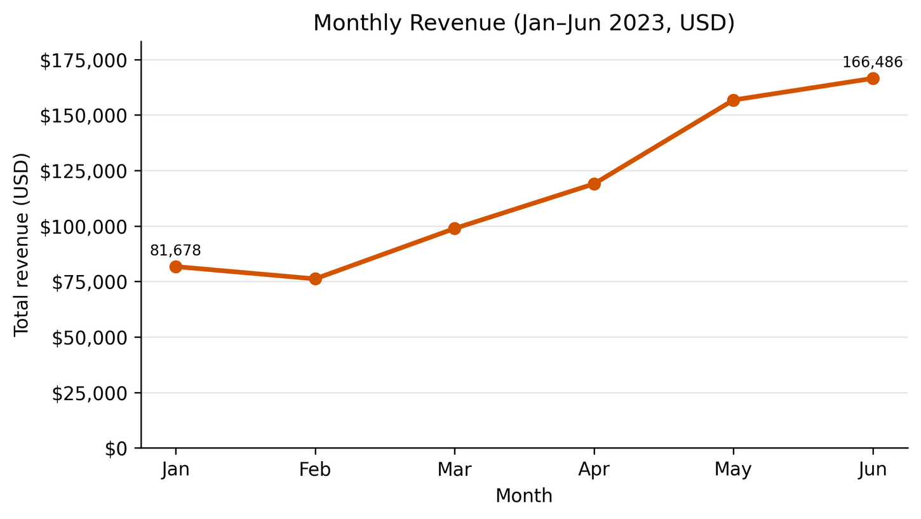
EDA - Monthly Trend

Slide 13
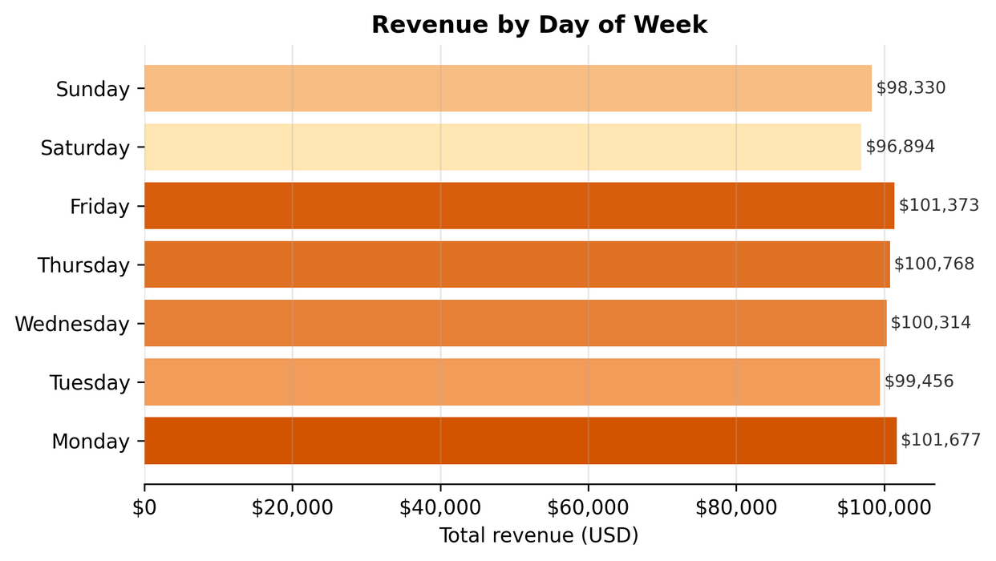
EDA - Day-of-Week Trend
Day-of-Week Trends: Sales remain steady across all days, with only minor differences between weekdays and weekends.
Monday and Friday show slightly higher revenue.
Saturday is marginally lower, indicating consistent but not weekend-dependent demand.

Slide 14
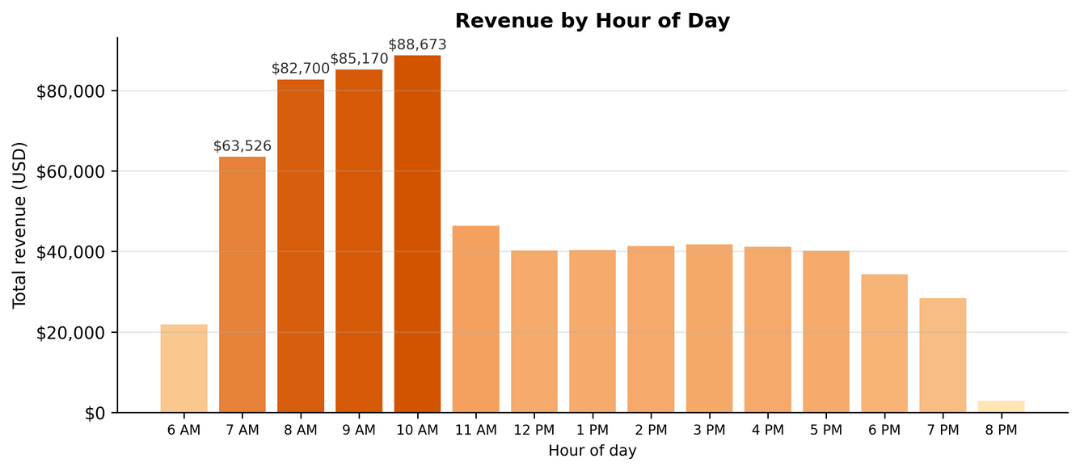
EDA – Hour-of-Day Trend
Time-of-Day Trends:
Strong morning concentration from 7 AM – 11 AM, contributing over 50 % of total revenue.
10 AM is the single highest-earning hour, followed by 8 - 9 AM, reflecting commuter coffee demand.
Afternoon sales are steady but moderate, signaling potential for off-peak promotions.

Slide 15
EDA - Store Performance by Location
Balanced Revenue Split: All three stores contribute almost equally to total revenue (~33% each of $698.8K).
Top Performer: Hell’s Kitchen leads slightly at ≈ $236.5K, followed by Astoria (~ $232.2K) and Lower Manhattan (~ $230.1K).
Customer Reach: Comparable transaction volumes across all stores indicate consistent demand and similar customer bases.
Key Takeaway: Store performance is balanced, suggesting that location is not a major differentiator - operations and customer traffic remain strong across all regions.

Slide 16
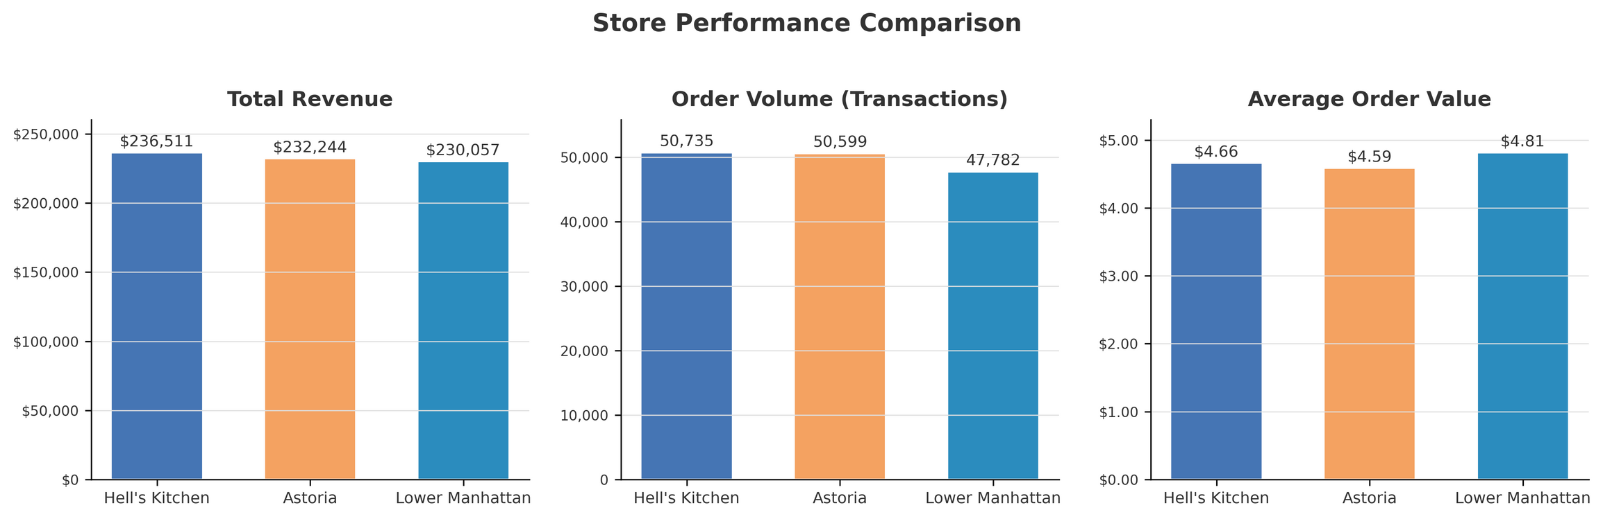
EDA - Store Performance by Location

Slide 17
EDA - Product Category Performance
Core Revenue Drivers: Coffee ($269.9K, ~38.6%) and Tea ($196.4K, ~28.1%) are the main revenue pillars, together contributing nearly 67% of total sales.
Supporting Categories: Bakery ($82.3K, ~11.8%) and Drinking Chocolate ($72.4K, ~10.4%) add meaningful cross-sell opportunities and drive combo purchases.
Niche Offerings: Coffee Beans (~5.7%) and smaller packaged goods contribute less overall but may carry higher profit margins and brand value.
Key Takeaway: The shop’s success relies heavily on beverage sales, while complementary food and specialty items support upselling and diversification.

Slide 18
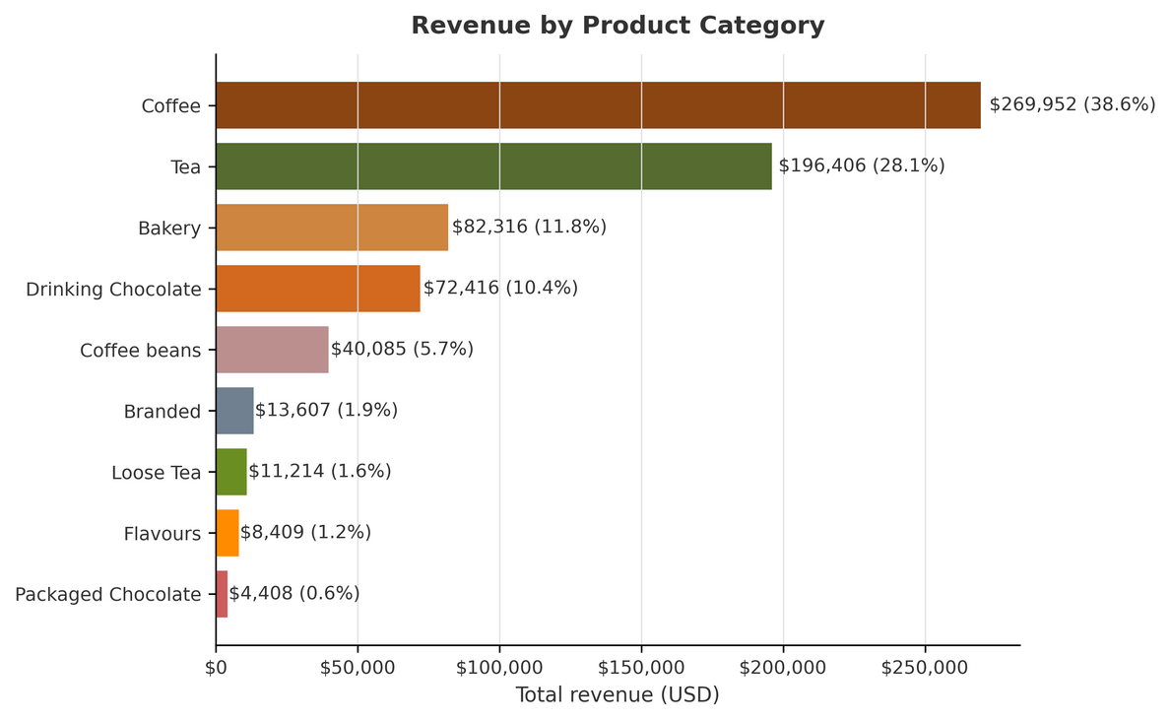
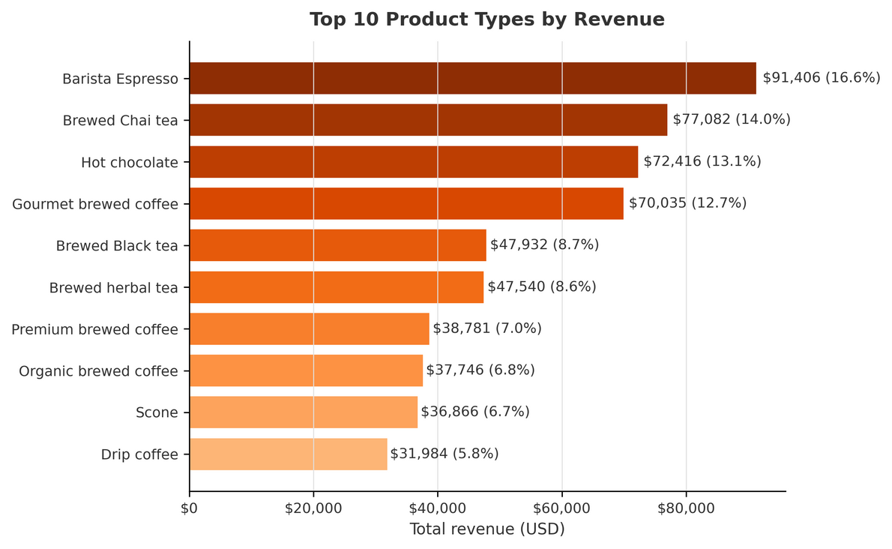
EDA - Product Category Performance

Slide 19
Summary of Key Insights - Time & Traffic
Revenue doubled from $81.7 K in January to $166.5 K in June, showing strong upward growth.
Transaction volume increased proportionally, confirming genuine customer expansion rather than price effects.
May and June marked the highest-performing months, indicating seasonal momentum.
Sales remained consistent across all weekdays, with no major weekday-weekend variation.
More than 50 % of total revenue occurred between 7 AM and 11 AM, highlighting the dominance of morning demand.
10 AM was the peak hour for both transactions and revenue.
Key takeaway: Morning hours drive business performance and should guide staffing and promotional planning.

Slide 20
Key Insights - Store & Product Insights
All three stores generated similar revenue, each contributing roughly one-third of total sales ($698.8K).
Lower Manhattan recorded the highest average order value (AOV), suggesting stronger premium-product purchasing behavior.
Coffee and Tea categories dominated overall performance, accounting for about two-thirds of total revenue.
Bakery and Drinking Chocolate items served as effective complementary products for cross-selling opportunities.
Top-selling product types included Barista Espresso, Brewed Chai Tea, Hot Chocolate, and Gourmet Brewed Coffee.
Product preferences were consistent across stores, indicating a uniform customer profile.
Afternoon and evening sales were moderate, offering scope for targeted off-peak promotions.

Slide 21
Conclusion
RQ1 - How do sales vary over time?
Sales showed a strong upward trend, with revenue more than doubling from January ($81.7K) to June ($166.5K).
Morning hours (7–11 AM) consistently generated over half of total revenue, confirming demand peaks during commuter times.
RQ2 - How do store locations differ?
All three stores performed similarly in total revenue, indicating balanced demand.
Lower Manhattan had the highest AOV, suggesting greater premium product purchasing.
RQ3 - Which products drive performance?
Coffee and Tea are the core revenue categories, together accounting for about two-thirds of total sales.
Top-performing product types include Barista Espresso, Brewed Chai Tea, and Hot Chocolate; these items should be kept highly available and prominently featured across all stores.

Slide 22
Conclusion
RQ4 - What are the business recommendations?
Staffing:
Maintain maximum staff between 7-11 AM, especially during 8-10 AM peak hours.
Reduce evening staffing while ensuring steady service quality.
Inventory & Menu:
Prioritize Coffee, Tea, Bakery, and Drinking Chocolate stock.
Promote coffee beans and premium drinks more at Lower Manhattan, given its higher AOV.
Marketing & Promotions:
Introduce combo offers (coffee + bakery) during morning peaks.
Run targeted afternoon promotions to boost off-peak sales.
Highlight best-selling items in menus, loyalty apps, and in-store signage.

Slide 23



